Slide 1

SC3010 Project
Group 31

Slide 2


Computer Security Project
01
02
Mirai
Emotet
Botnet Malware
Trojan Malware

Slide 3
Mirai

Slide 4

Mirai
Characteristics
Mirai scans the Internet for IoT devices that run on the ARC processor.
Runs a stripped-down version of the Linux operating system.
If the default username-and-password combo is not changed, Mirai is able to log into the device and infect it.
Mirai employs reflection and amplification techniques to enhance the attack.
Reflection involves sending traffic from infected devices to a third-party server, which then reflects the traffic back to the target, concealing the source.
Amplification exploits vulnerabilities in protocols like DNS and NTP, allowing the botnet to generate much larger traffic volumes than it initially sends, making the attack more powerful.
Notes:
Malware Delivery: Acts as a "loader" to install any type of malware (ransomware, spyware, etc.).
Rapid Spread: Uses infected email accounts to spam contacts and brute-force network access.
Evasion: Detects and adapts to its environment to avoid removal or detection.

Slide 5


Mirai
CVE
No CVEs associated with original Mirai malware
Notes:
Malware Delivery: Acts as a "loader" to install any type of malware (ransomware, spyware, etc.).
Rapid Spread: Uses infected email accounts to spam contacts and brute-force network access.
Evasion: Detects and adapts to its environment to avoid removal or detection.

Slide 6






Mirai Attack Flow
5. Command
6. Relay
2. Report
Attacker
C2 Server
Bots
Report Server
IP Scan
3. Dispatch
7. DDOS
4. Load
Target
IOT Devices
Loader

Slide 7
Attack Framework
Initial Access: Brute force login attempts using default or weak credentials
Execution: Executes shell commands to load malware and run its binary.
Defence Evasion: Kills processes related to other competing malware or services that might interfere
Command and Control: Communicates with C2 servers over TCP
Discovery: Scans the random IP for device with open Telnet/SSH/HTTP ports.
Lateral Movement: Exploit weak login to spread to other devices on the network
Impact: Network Denial of Service to targets

Slide 8
Impacts
First attack on OVH
Journalist Blog Attack
Mirai’s first attack was towards a French technology company OVH in September 2016, It peaked at 1Tbps and estimated to have about 145,000 devices for the assault
A blog created by the journalist Brian Krebs was flooded with > 600GB data in September 2016, likely targeted due to his line of investigative journalism

Slide 9
Mirai
Source Code
Repository is released by the author online
Bot
IP scan
Dictionary table
Kills remote connection ports
Command and Control (C2) Server
Listens to callbacks from bots
Handles commands from attacker
Loader
Loads malware onto target device
Notes:
Malware Delivery: Acts as a "loader" to install any type of malware (ransomware, spyware, etc.).
Rapid Spread: Uses infected email accounts to spam contacts and brute-force network access.
Evasion: Detects and adapts to its environment to avoid removal or detection.

Slide 10
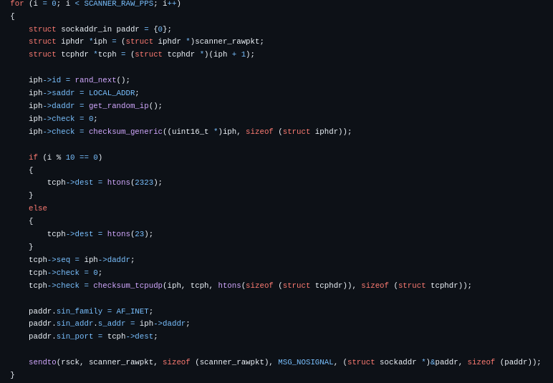
Source Code Analysis
IP Scan
Scans networks by randomly generating IP addresses

Slide 11
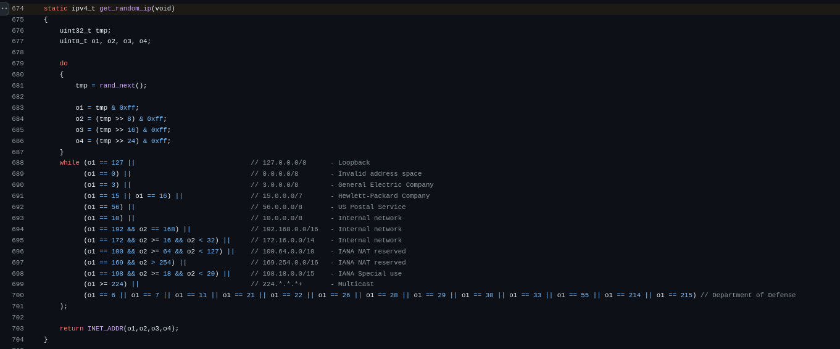
Source Code Analysis
Scans networks by randomly generating IP addresses
Whitelist of IP addresses

Slide 12
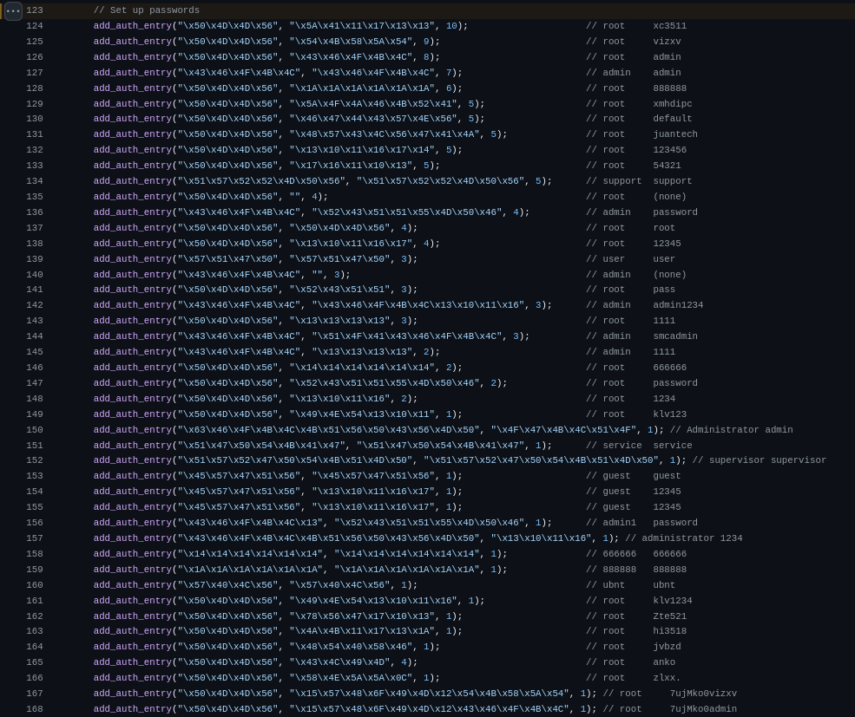
Source Code Analysis
Dictionary Attack
List of common user - password pairs stored in code
Used to attempt multiple login with these credentials

Slide 13
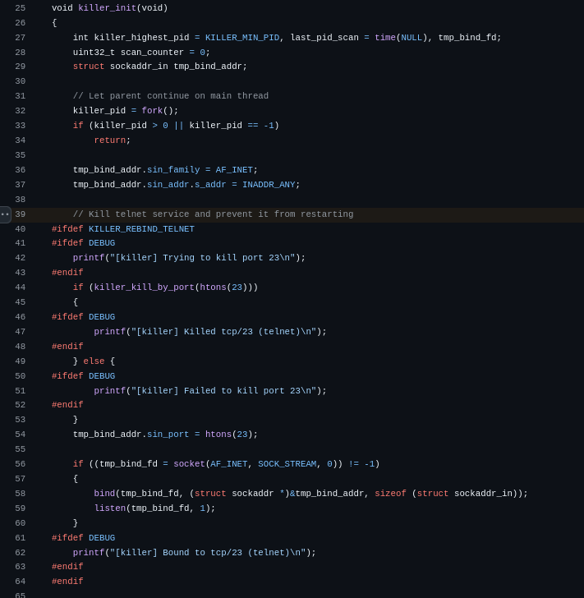
Source Code Analysis
Found in killer.c, called when access is retrieved
Prohibits remote connection attempts to device (telnet, ssh, https)

Slide 14
Learning Points
Authentication
Do not use common username and passwords for credentials
Many had left their login credentials to be the default username-and-password combo
Segment your network
Do not leave your devices exposed to the internet
Ensure that devices are separate from critical sections of daily applications

Slide 15

Tech Demo

Slide 16


Network Topology
Attacker/C2 Server
192.168.1.2
2 Bots
192.168.1.20
192.168.1.25
WireShark intermediary
192.168.1.40
Target
192.168.1.30

Slide 17
Emotet
Notes:
I am Chermine
Now we will talk about the second case study on Emotet

Slide 18
Emotet (Trojan)
Characteristics
Started as a Banking Trojan
Malware Delivery
Rapid, Worm-Like Spread
Advanced Anti-Detection Tactics
Notes:
It is a type of trojan malware
It has the following characteristics:
Originally, Emotet started as a banking trojan, stealing sensitive information.
But over time, it evolved into something much more powerful:
It became a malware delivery platform, which means it installs and runs other types of malware.
It spreads in a worm-like fashion, quickly moving across networks and infecting other machines automatically.
It uses advanced anti-detection tactics to avoid being caught by antivirus software, making it harder to detect and remove once it’s in the system.

Slide 19


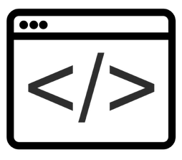

How Does Emotet Works?
Phishing Email
Malicious Macro
Macro Executed to
Download Emotet
Contact C&C Server
& Execute Commands
Notes:
Let me walk you through the infection chain of Emotet.
It typically starts with a phishing email.
When the victim opens the attachment in that email, it contains a malicious macro.
If the user enables the macro, it executes a script, such as PowerShell or JavaScript. This script’s job is to download the Emotet malware onto the system.
Once Emotet is installed, it reaches out to a C2 server to receive further instructions.
At this point, the attacker can download additional malware, steal data, or even use the infected machine to spread Emotet further inside the network.

Slide 20
Attack Framework
Initial Access: Gain entry through malicious email attachments
Execution: User opens the malicious document and enables macros
Persistence: Adding registry keys or creating entries in the startup folder
Privilege Escalation: Injects code into legitimate processes to escalate privileges
Defense Evasion: Obfuscation techniques to evade detection
Credential Access: Attempts to brute-force network passwords to facilitate lateral movement
Discovery: Collects information about the system to inform its next steps
Lateral Movement: Spreads to other systems via SMB shares
Command and Control: Communicates with C2 servers over standard web protocols
Impact: In some cases, delivers ransomware leading to data encryption
Notes:
This slide outlines the 10 key stages in Emotet’s attack lifecycle.
1. Initial Access: Emotet enters through phishing emails with malicious attachments.
2. Execution: When the user enables macros, the malware executes.
3. Persistence: It adds itself to the startup folder or registry to survive reboots.
4. Privilege Escalation: Injects code into system processes to gain higher privileges.
5. Defense Evasion: Uses obfuscation to bypass antivirus detection.
6. Credential Access: Attempts to brute-force network passwords.
7. Discovery: Scans the system and network for further targets.
8. Lateral Movement: Spreads via SMB to other devices in the network.
9. Command and Control: Connects to C2 servers for instructions and payloads.
10. Impact: Can deploy ransomware or steal data, causing major disruptions.
Emotet operates like a professional-grade toolkit, following a structured, stealthy approach that makes it highly effective and dangerous.

Slide 21
Impacts
Rockingham County Schools
Through a phishing email
Caused damage to school’s network
Disabled for approximately two weeks
Caused more than $1.4 million in losses (virus mitigation services, replacement computers etc)
Notes:
Now let’s take a look at the real-world impact of Emotet in the case of Rockingham County Schools.
This attack started with a phishing email. Once the malicious attachment was opened, the malware infiltrated the school’s network.
The damage was severe. Their systems were completely disabled for two weeks.
Beyond downtime, the financial impact was massive with over $1.4 million in losses.
This case clearly highlights how a single phishing email can escalate into a full-blown cyber crisis.

Slide 22
Vulnerabilities Exploited
CVE-2021-43890
Microsoft Windows AppX Installer Spoofing Vulnerability
Allows attackers to craft malicious AppX packages that appear as legitimate applications
Severity: 7.1/10 (High)
Affected Versions:
Windows 10 Version 1507, 1709, 1803, 1809, 1903, 1909 etc
Windows 11 Version 21H2
Notes:
One of the key vulnerabilities that can be exploited by Emotet is CVE-2021-43890, a spoofing vulnerability in the Microsoft Windows AppX Installer.
This flaw allows attackers to create malicious AppX packages and make them appear as legitimate apps. If a user installs one of these spoofed apps, it could be used to silently deploy malware, such as Emotet, in the background.
This vulnerability has a CVSS score of 7.1 out of 10, placing it in the high severity category. It affects multiple versions of Windows.

Slide 23


Source Code Analysis
Delivery
Emails sent with links to websites delivering Microsoft Word documents
hxxp://honamcharity.ir/mmth4/Documentation/gepvh74lcq7h/
hxxp://lvita.co/tmp/Reporting/
These Microsoft Word documents contain embedded Macros and
enabling the content launches the code in the macros.
Defanged URLs of website links
Scripting

Slide 24
Code Analysis
Exploitation
The macro uses the Windows Management Instruction (WMI) to execute a hidden PowerShell command
Create WMI Class is used to create new processes
Access the WMI to manage processes
Hide the PowerShell window to avoid user detection and allow the execution of a Base64 encoded Powershell command.

Slide 25
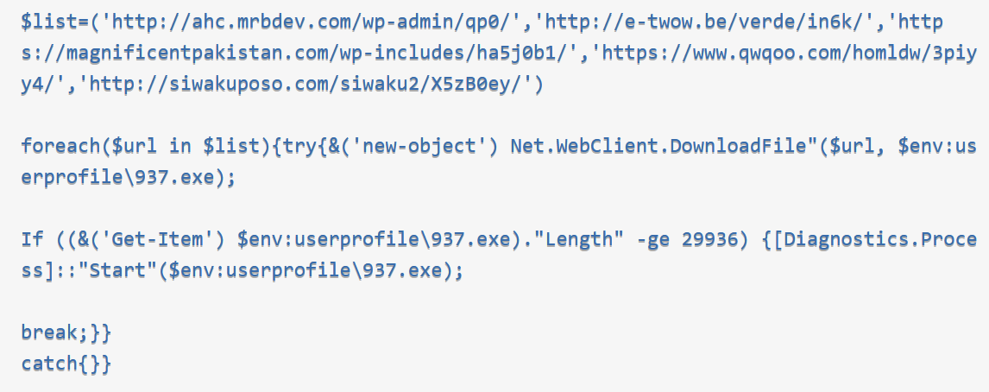
Code Analysis
Installation
Download of Emotet payload as 937.exe
List array conataining URLs for downloading the payload.
Download a file from the given URLs in the given order and saves the file in the $env:userprofile directory as 937.exe
After checking that the file is downloaded properly by verifying that the size is 29936 bytes or more the payload is executed.

Slide 26
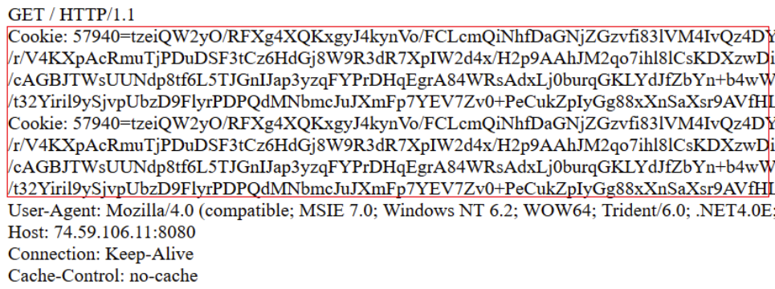
Code Analysis
Command and Control
Emotet makes use of several HTTP protocol to:
Receive commands
Exfiltrate Data
It performs the communications by performing an HTTP GET request (this includes passing data in the form of a browser cookie)
The server then responds with a set of further instructions.
Communication with Command and Control (C2) Servers
Transmitting Data to C2 servers in the form of a cookie (whoever in reality it is not a cookie)

Slide 27
Learning Points
Phishing remains as one of the most effective methods for delivery of malware.
Macros can easily be weaponized to execute system level commands. Hence there is a need to:
Disable macros execution by default.
Implement document scanning for documents in emails.
Several stealth tactics were employed such as:
No UI was shown
No prompts were given
No warning was given to the user
The PowerShell command window was hidden
The use of WMI to create a malicious process.
Notes:
Now let’s take a look at the real-world impact of Emotet in the case of Rockingham County Schools.
This attack started with a phishing email. Once the malicious attachment was opened, the malware infiltrated the school’s network.
The damage was severe. Their systems were completely disabled for two weeks.
Beyond downtime, the financial impact was massive with over $1.4 million in losses.
This case clearly highlights how a single phishing email can escalate into a full-blown cyber crisis.

Slide 28
Thank You
Notes:
Now let’s take a look at the real-world impact of Emotet in the case of Rockingham County Schools.
This attack started with a phishing email. Once the malicious attachment was opened, the malware infiltrated the school’s network.
The damage was severe. Their systems were completely disabled for two weeks.
Beyond downtime, the financial impact was massive with over $1.4 million in losses.
This case clearly highlights how a single phishing email can escalate into a full-blown cyber crisis.

Slide 29
Limitations of Traditional Security Approaches
Signature-Based Detection
Rule-Based Systems
Manual Analysis
Relies on known attack patterns, making it ineffective against zero-day attacks.
Difficult to adapt to rapidly changing threats and can lead to false positives.
Time-consuming and prone to human error, especially in dealing with large volumes of data.

Slide 30
Fundamentals of AI and Machine Learning
1. Machine Learning Algorithms
2. Supervised Learning
These algorithms learn from data patterns to make predictions and decisions.
Training models on labeled data to classify and predict outcomes.
3. Unsupervised Learning
4. Reinforcement Learning
Identifying patterns in unlabeled data for anomaly detection and clustering.
Training agents to learn through trial and error and optimize actions over time.

Slide 31
Automating Vulnerability Management
01
02
03
Vulnerability Scanning
Patch Management
Risk Assessment
AI can automate vulnerability assessments and prioritize critical vulnerabilities.
AI can recommend and schedule patch deployments to mitigate vulnerabiliti
es. AI can assess the impact and likelihood of vulnerabilities to prioritize remediation efforts.

